Slide 2
The SOLID principles are a set of five design principles that were introduced by Robert C. Martin (also known as Uncle Bob) to help software developers create more maintainable, flexible, and scalable code.
These principles have become fundamental in object-oriented programming and are widely used in modern software development.

Slide 3
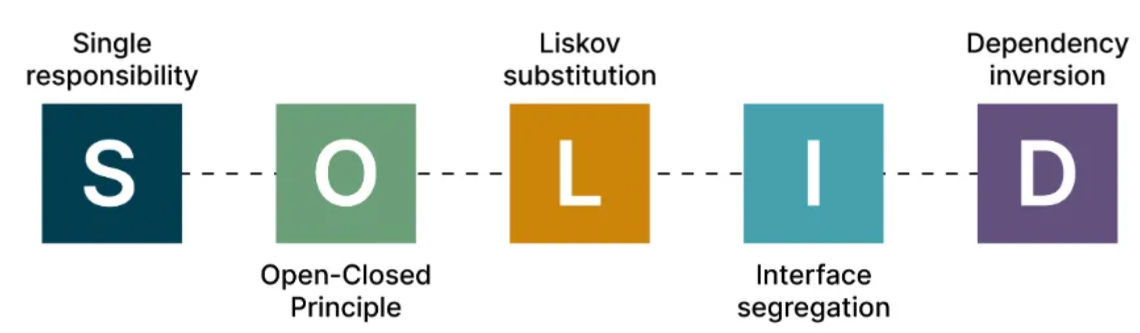

Slide 4
SOLID Stands for
S : Single Responsibility Principle (SRP)
O : Open closed Principle (OSP)
L : Liskov substitution Principle (LSP)
I : Interface Segregation Principle (ISP)
D : Dependency Inversion Principle (DIP)

Slide 5
Single Responsibility Principle
This principle states that “a class should have only one reason to change” which means every class should have a single responsibility or single job or single purpose

Slide 6
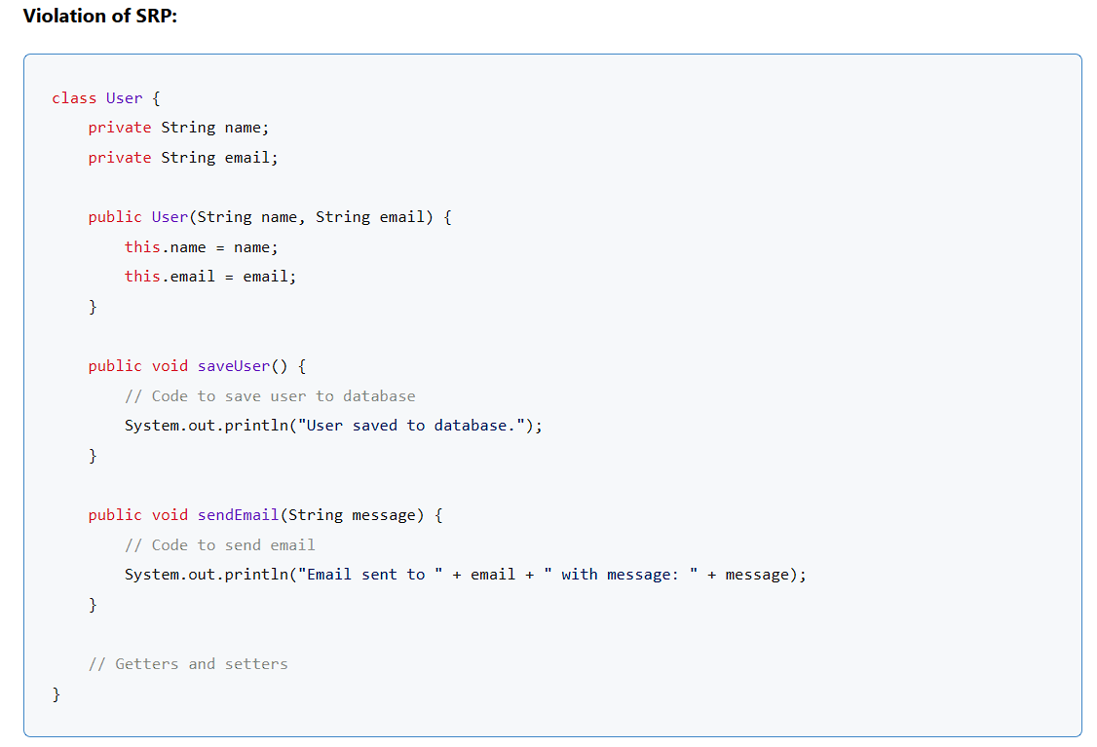

Slide 7
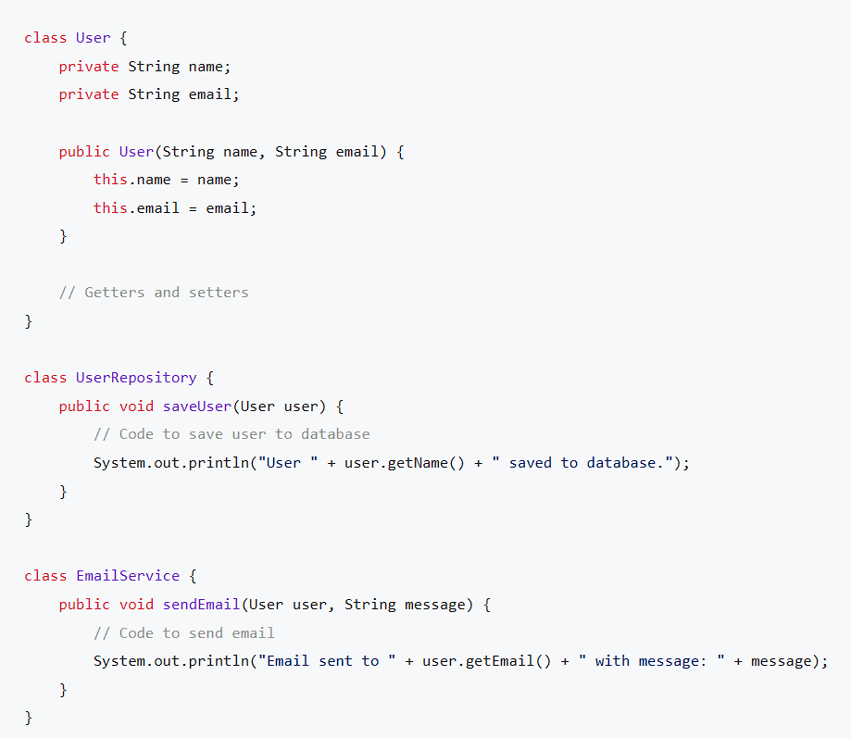

Slide 8
public class Main {
public static void main(String[] args) {
User user = new User(“Rohit Sharma", “rohit.sharma@gmail.com");
UserRepository userRepository = new UserRepository();
userRepository.saveUser(user);
EmailService emailService = new EmailService();
emailService.sendEmail(user, "Welcome to our platform!");
}
}

Slide 9
2. Open/Closed Principle (OCP)
The Open/Closed Principle states that software entities (classes, modules, functions, etc.) should be open for extension but closed for modification.
In simpler terms, you should be able to add new functionality without modifying the existing code.

Slide 10
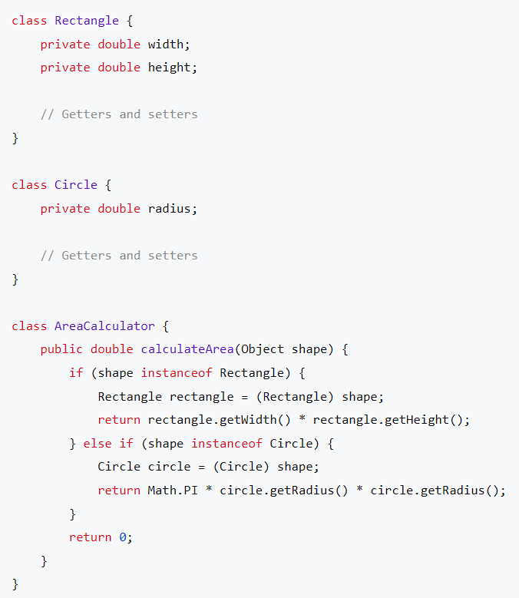

Slide 11
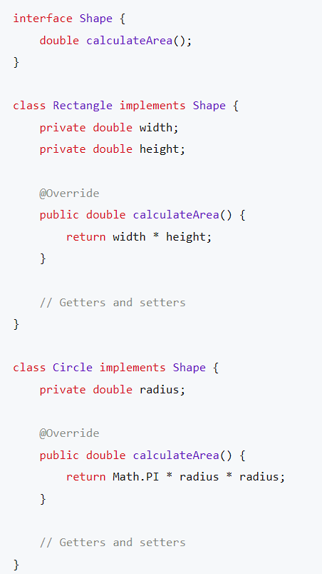

Slide 12
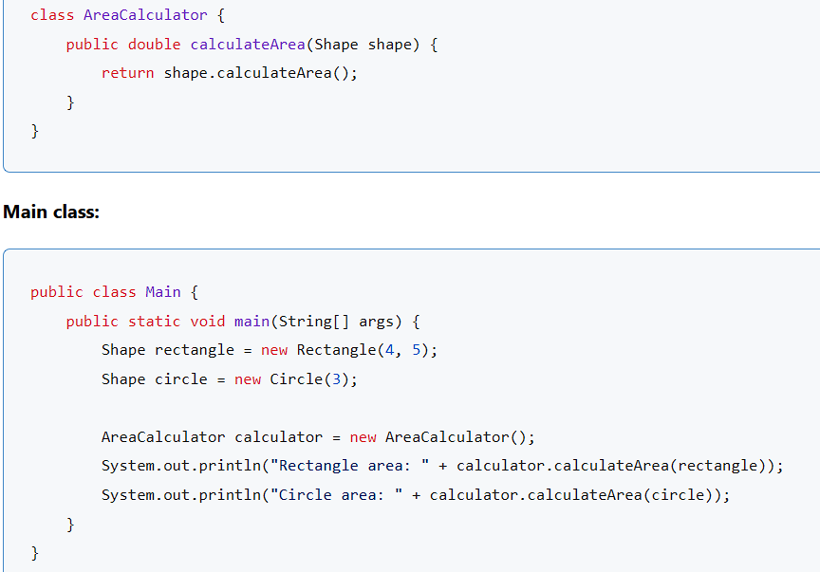

Slide 13
3. Liskov Substitution Principle (LSP)
The Liskov Substitution Principle states that subtypes must be substitutable for their base types.
In other words, if you have a base class and a derived class, you should be able to use instances of the derived class wherever instances of the base class are expected, without affecting the correctness of the program.

Slide 14
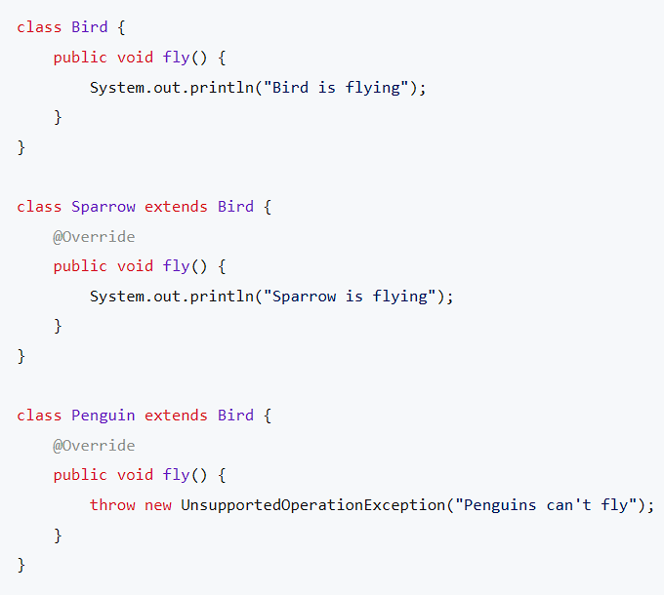

Slide 15
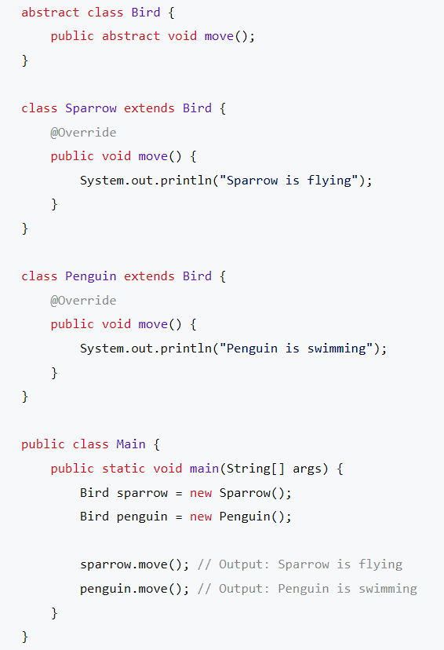

Slide 16
4. Interface Segregation Principle (ISP)
The Interface Segregation Principle states that clients should not be forced to depend on interfaces they don’t use.
In other words, it’s better to have many smaller, focused interfaces than a large, monolithic interface.

Slide 17
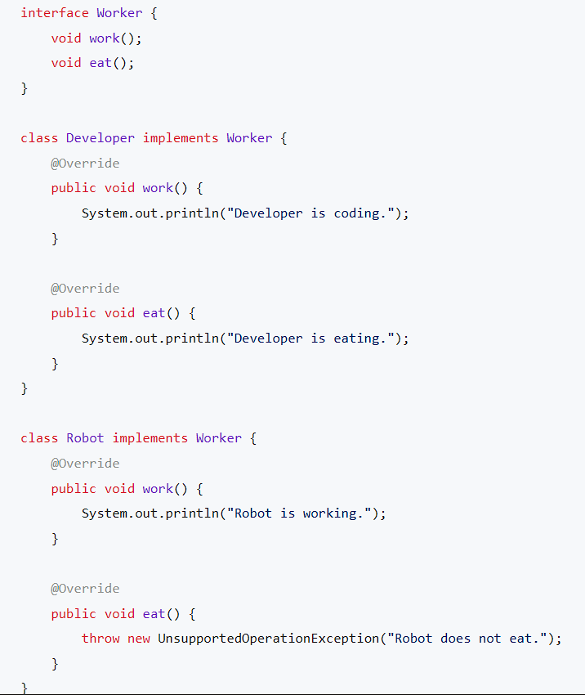

Slide 18
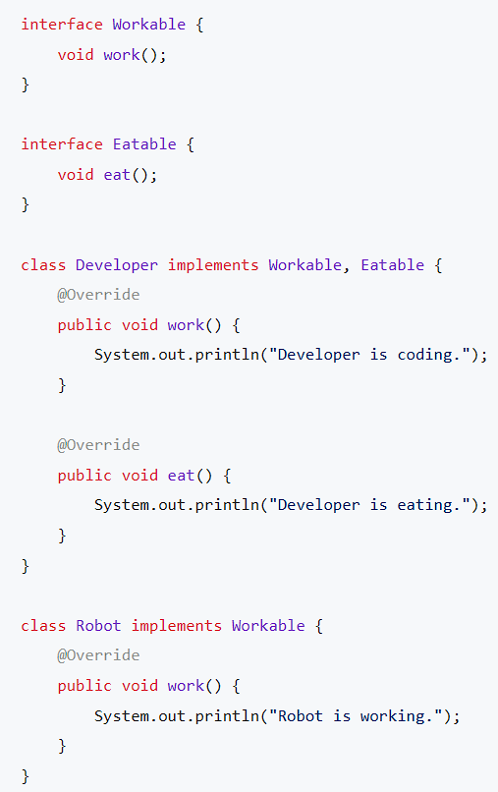

Slide 19
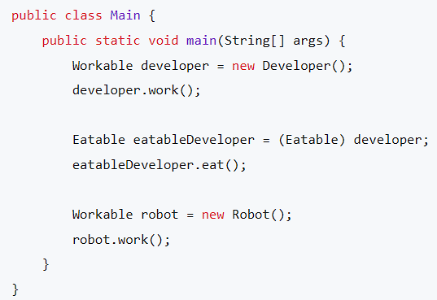

Slide 20
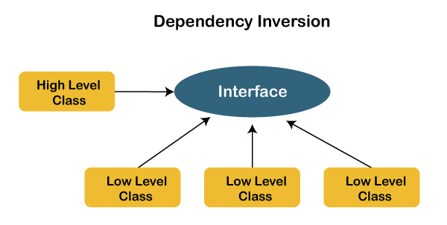
Dependency Inversion Principle (DIP)
The principle states that we must use abstraction (abstract classes and interfaces) instead of concrete implementations.
High-level modules should not depend on the low-level module but both should depend on the abstraction

Slide 21
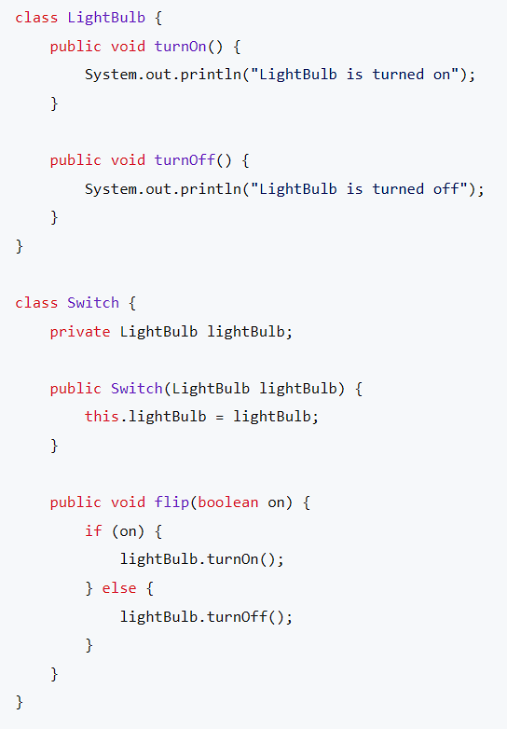

Slide 22
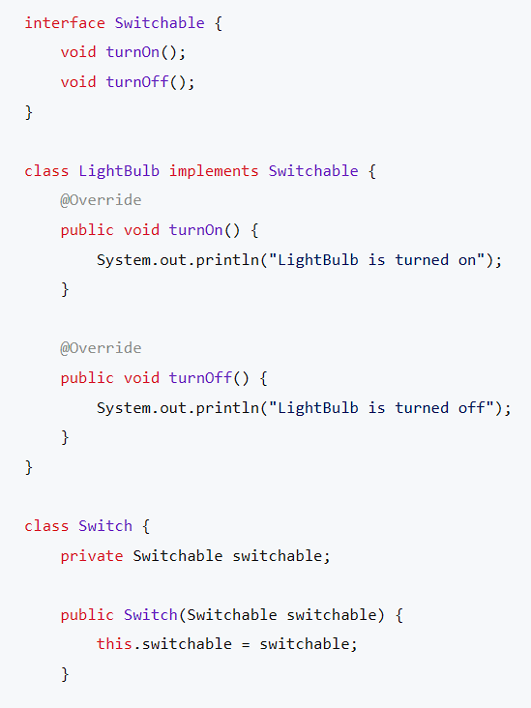

Slide 23
